Slide 1


CSE 848 Artificial Intelligence Generative Adversarial Networks (GANs)
Prof. Dr. Yasar Ayaz
(Pride of Performance)
Chairman / Central Project Director
National Center of Artificial Intelligence (NCAI)
Pakistan
Professor & Founding Head
Department of Robotics & AI
NUST-SMME

Slide 2
Introduction
Introduced by Ian Goodfellow in 2014¹
A class of machine learning models used for generative tasks.
Composed of two neural networks: Generator and Discriminator.
Inspired by game theory, with both networks competing to improve performance.
¹Goodfellow, J. Pouget-Abadie, M. Mirza, B. Xu, D. Warde-Farley, S. Ozair, A. Courville, and Y. Bengio, "Generative adversarial networks," Communications of the ACM, vol. 63, no. 11, pp. 139–144, Oct. 2020, doi: 10.1145/3422622.

Slide 3
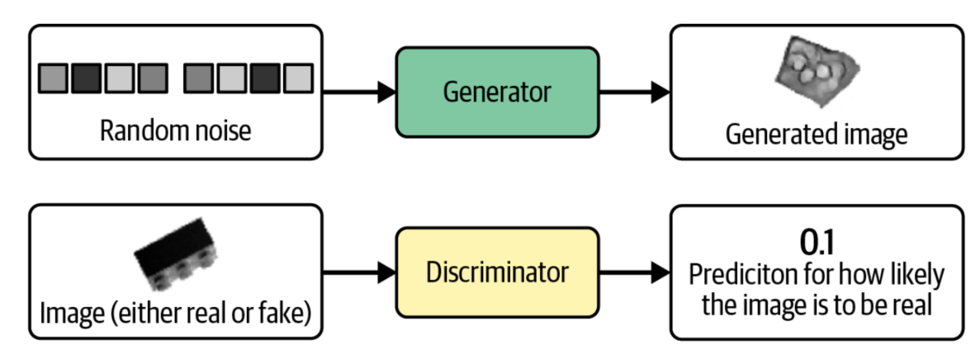
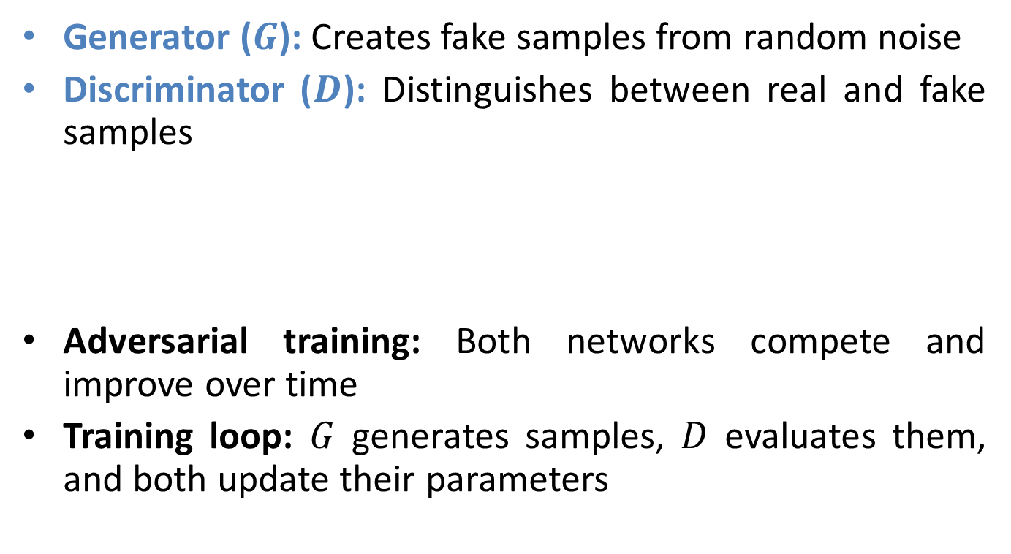
How GANs Work
Generator ($G$): Creates fake samples from random noise
Discriminator ($D$): Distinguishes between real and fake samples
Adversarial training: Both networks compete and improve over time
Training loop: $G$ generates samples, $D$ evaluates them, and both update their parameters

Slide 4
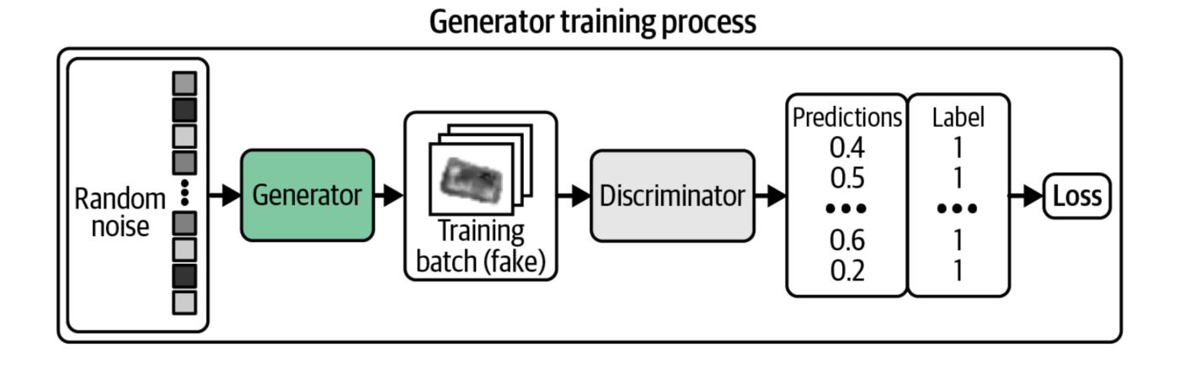

Generator ($G$)
Multivariate standard normal distribution
Generator Output
Fake Images

Slide 5
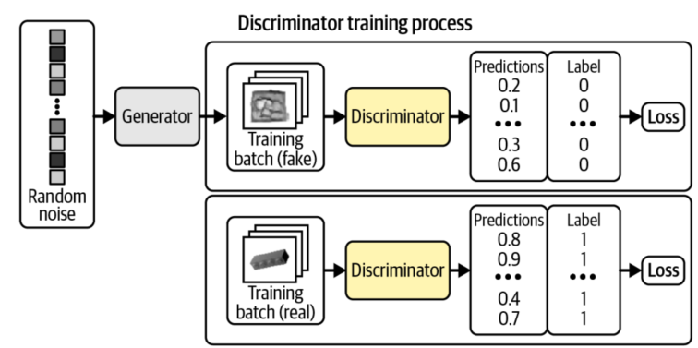


Discriminator ($D$)
$$close to 1 (Real)$$

Slide 6
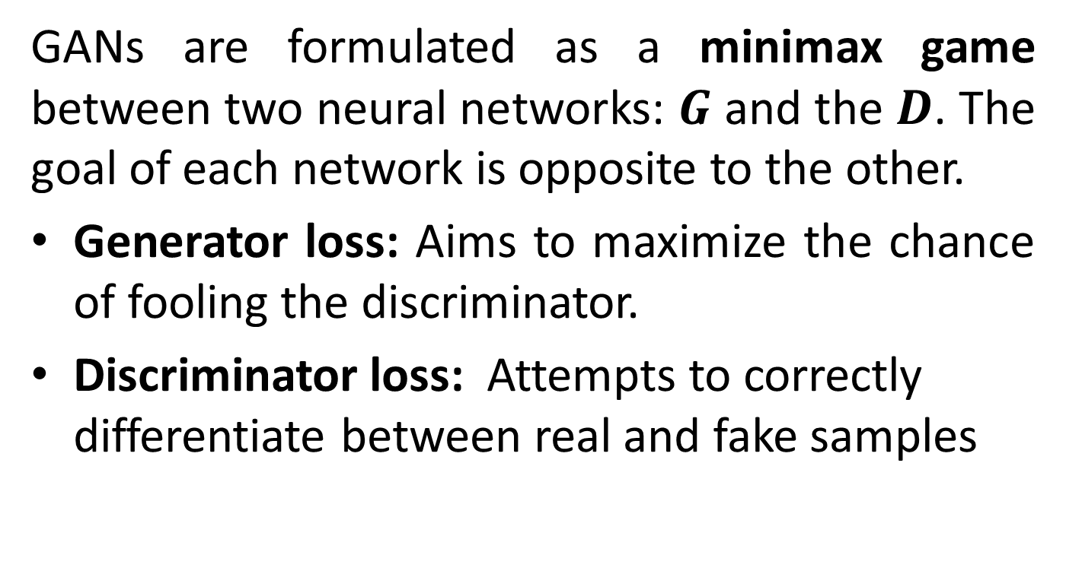
Objective Functions
GANs are formulated as a minimax game between two neural networks: $G$ and the $D$. The goal of each network is opposite to the other.
Generator loss: Aims to maximize the chance of fooling the discriminator.
Discriminator loss: Attempts to correctly differentiate between real and fake samples

Slide 7
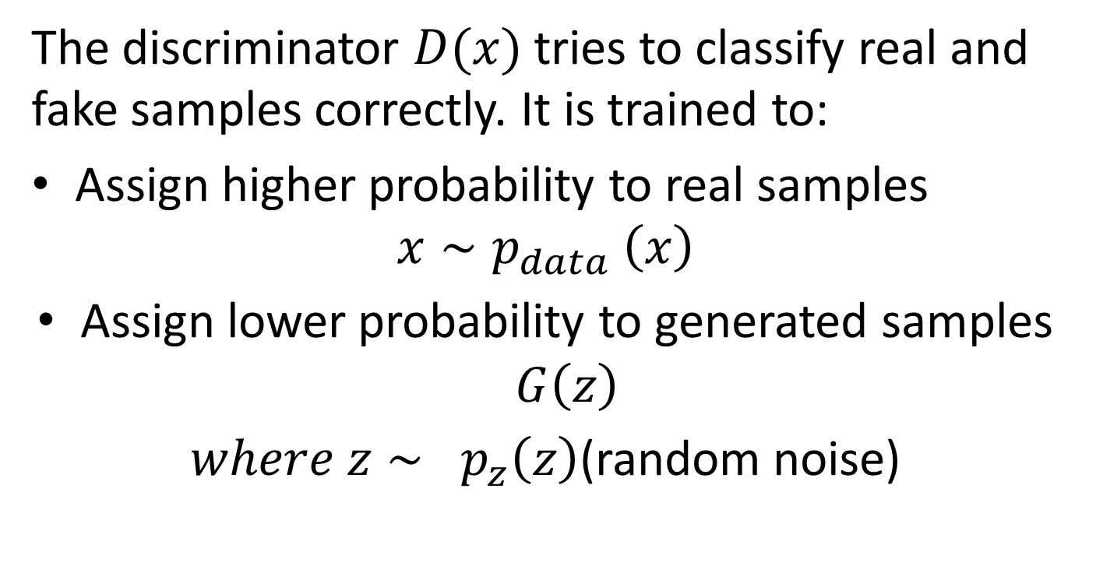
Discriminator Loss
The discriminator $D(x)$tries to classify real and fake samples correctly. It is trained to:
Assign higher probability to real samples
$$x∼p_{data} \left(x\right)$$
Assign lower probability to generated samples $G\left(z\right)$
$where z∼ p_{z}\left(z\right)$(random noise)

Slide 8
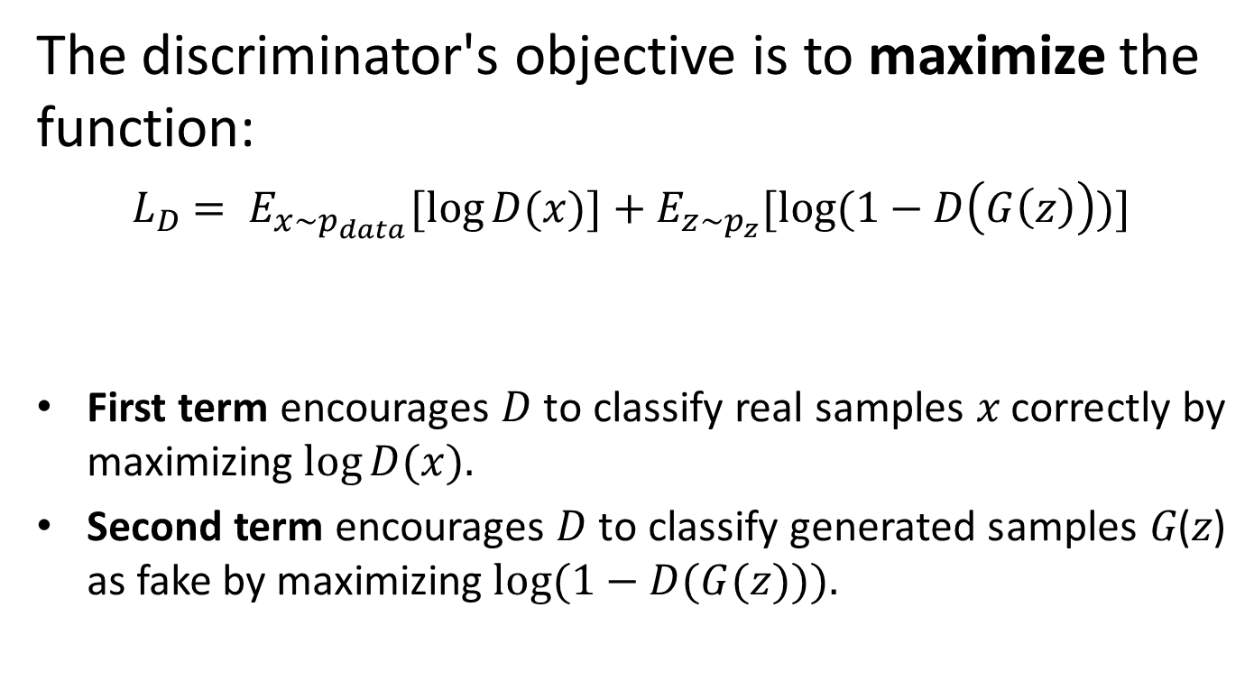
Discriminator Loss (cont)
The discriminator's objective is to maximize the function:
$L_{D}$ $= E_{x\sim p_{data}}[\log{D(x)]+E_{z\sim p_{z}}[log⁡(1−D\left(G\left(z\right)\right))]}$
First term encourages 𝐷 to classify real samples 𝑥 correctly by maximizing $log⁡D(x).$
Second term encourages 𝐷 to classify generated samples 𝐺(𝑧) as fake by maximizing $log⁡(1−D(G(z))).$
First term
Second term

Slide 9
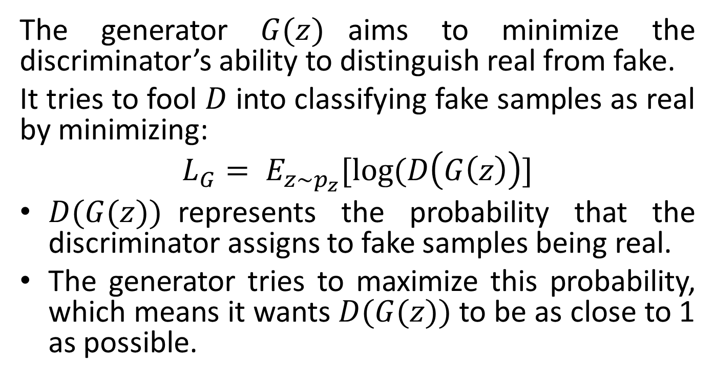
Generator Loss
The generator $G(z)$aims to minimize the discriminator’s ability to distinguish real from fake.
It tries to fool $D$ into classifying fake samples as real by minimizing:
$$L_{G}= E_{z\sim p_{z}}[log⁡(D\left(G\left(z\right)\right)]$$
$D(G(z))$represents the probability that the discriminator assigns to fake samples being real.
The generator tries to maximize this probability, which means it wants $D(G(z))$to be as close to 1 as possible.

Slide 10
Overall Loss
Since the generator minimizes this function while the discriminator maximizes it, the overall minimax objective becomes:
The Discriminator maximizes this function (better classification).
The Generator minimizes this function (better generation).

Slide 11
Challenges in GANs
Mode Collapse: Generator produces limited variations, reducing diversity
Training Instability: Difficult to balance generator and discriminator learning rates
Vanishing Gradients: Discriminator learns too fast, leaving generator stuck
Evaluation Metrics: No universal way to measure quality (e.g., Inception Score, FID)
Computational Cost: High training cost due to iterative adversarial training

Slide 12
Types of GANs
Vanilla GAN: Basic implementation with fully connected networks
Deep Convolutional GAN (DCGAN): Uses CNNs for better image generation
Conditional GAN (cGAN): Incorporates additional labels to control output
StyleGAN: Generates high-quality and controllable images
CycleGAN: Translates images between domains without paired data

Slide 13
Applications of GANs
Image Synthesis: Used in DeepFake technology and realistic face generation
Super-Resolution: Enhancing image quality (e.g., improving old photos)
Data Augmentation: Creating synthetic datasets for training AI models
Video Generation: Creating animations and realistic video scenes
Text-to-Image Generation: Models like DALL·E convert textual descriptions into images
Medical Imaging: Generating synthetic medical scans for research

Slide 14
Conclusion
GANs are powerful tools for generative modeling across various domains.
Ongoing research focuses on improving stability, realism, and control.
Ethical implications and responsible AI development are crucial moving forward.

